Slide 1


The Medieval World
Presented By:
Maqsood Ahmed
Hamza Hassan
Muhammad Zeeshan Khan
Ammaduddin Yousaf

Slide 2
What is the Medieval World?
The Medieval World refers to the period in European history spanning from the 5th to the 15th century, following the fall of the Roman Empire. This era was marked by the rise of Christianity, the formation of powerful kingdoms, and the development of a feudal social structure.
During this time, the continent was shaped by the spread of Christianity, the expansion of the Byzantine Empire, and the emergence of the Islamic civilization. The Medieval World saw the construction of grand cathedrals, the flourishing of monasteries, and the growth of universities, all of which contributed to the intellectual and cultural development of Europe.

Slide 3
Timeline Highlights
260 CE: Plotinus founds Neo-Platonism
313 CE: Constantine’s Edict of Milan
622 CE: Prophet Muhammad’s Hejira
711 CE: Muslim conquest of Iberia
1099 CE: Christian crusaders capture Jerusalem
1453 CE: Fall of Constantinople
1492 CE: Columbus reaches the West Indies

Slide 4
The Roman Empire and Philosophy
Division of the Roman Empire into east and west
Limited role of philosophy in Roman culture, except for Stoicism
Influence of Christianity and marginalization of Greek philosophy

Slide 5
The Dark Ages
Decline of Europe after the fall of the Roman Empire
Dominance of the Church and limited philosophical inquiry
Survival of Platonism and Boethius’s translation of Aristotle’s Logic

Slide 6
Contributions of Islamic Philosophers:
Al-Farabi (872-950 CE):
Philosophy and Logic, Political Philosophy, Metaphysics and Epistemology
Avicenna (Ibn Sina) (980-1037 CE):
Medicine, Philosophy and Metaphysics
Averroes (Ibn Rushd)(1126-1198):
Commentaries on Aristotle, Philosophy and Theology, Legal and Political Theory

Slide 7
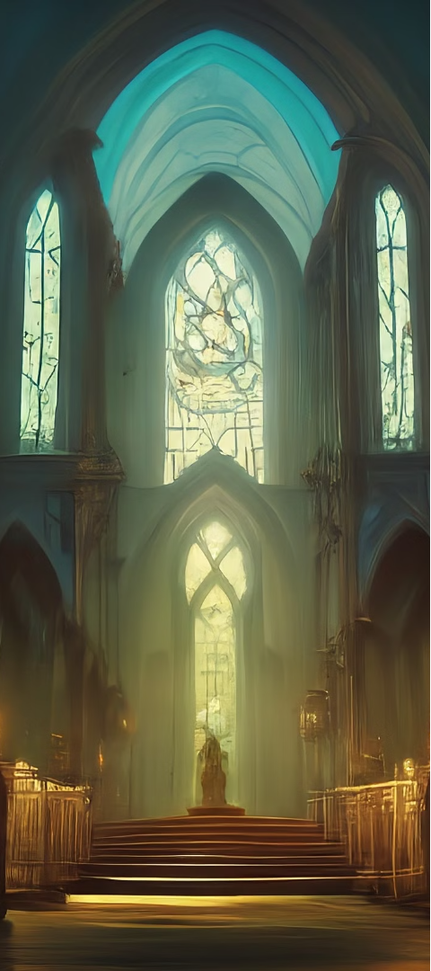
Compatibility with Christian Faith
1
Christian philosophers embrace
Aristotelianism
2
Promotion of compatibility between
Aristotle’s ideas and Christian doctrine
3
Contributions of key Christian philosophers
such as Thomas Aquinas

Slide 8
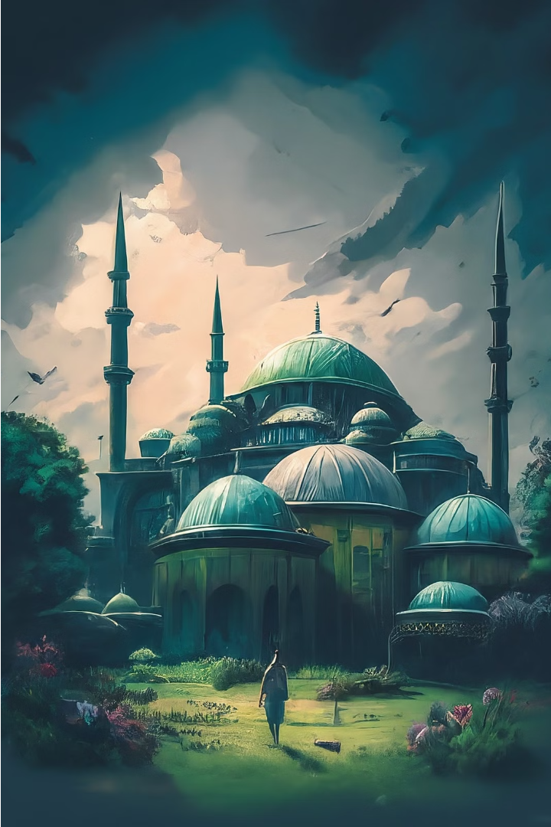
Introduction of New Rationality
Introduction of advanced scientific knowledge from the Islamic world to Europe
Shift towards reason and empirical inquiry during the Renaissance
Dissent within the Church and the onset of the Reformation

Slide 9
The Renaissance and Philosophy
Exploration of humanism and its impact on philosophical thought
Promotion of individualism and the pursuit of knowledge
Connection between Renaissance philosophy and the rise of modern science

Slide 10

Impact on Society
Reflection on the societal implications of philosophical evolution
Influence on governance, education, and cultural norms
Legacy of philosophical inquiry in shaping the modern world

Slide 11
Conclusion
The evolution of philosophy during the medieval period was marked by the integration of Greek philosophical traditions with Christian doctrine, the preservation and transmission of knowledge by Islamic and Jewish scholars, and the eventual revival of classical ideas leading to the Renaissance. This period saw the transition from a primarily faith-based understanding of the world to a more reason-oriented approach, laying the groundwork for modern philosophy and science.

Slide 12
Any Question?
(Silence is the best Answer! ☺)

Slide 13
Thank You

